Slide 1
Chapter 9
Copyright © 2012 Pearson Education, Inc.
An Introduction to Pointers

Slide 2
Outline
Objectives
Addresses and Pointers
Pointers to Array Elements
Problem Solving Applied: El Niño-Southern Oscillation Data
Dynamic Memory Allocation
Problem Solving Applied: Seismic Event Detection
Common Errors Using new and delete
Linked Data Structures
The C++ Standard Template Library
Problem Solving Applied: Concordance of a Text File
Copyright © 2012 Pearson Education, Inc.

Slide 3
Objectives
Develop problem solutions in C++ containing:
Addresses and pointers
Pointers to arrays
Dynamic memory allocation
Pointers with character strings
new and delete
Linked data structures
Classes from the C++ Standard Template Library
iterators
Copyright © 2012 Pearson Education, Inc.

Slide 4
Addresses and Pointers
Copyright © 2012 Pearson Education, Inc.

Slide 5
Addresses and Pointers
A pointer is an object that holds the memory address of another object.
If a variable p contains the address of another variable q, then p is said to point to q.
If q is a variable at location 100 in memory, then p would have the value 100 (q’s address).
  Memory snapshot:
p
q
Copyright © 2012 Pearson Education, Inc.

Slide 6
Address Operator
The operator & is called the address operator.
When the & operator is applied to an object, the result is the address of the object.
//Example:
int x=75;
cout << "x is " << x;
cout << "\nthe addres of x is " << &x << endl;
x
[0x7fff8164]
75
Copyright © 2012 Pearson Education, Inc.

Slide 7
Pointer Assignment
Pointer types are declared using the pointer operator *, also called the dereferencing operator.
When declaring more than one pointer variable, the * operator must precede each identifier.
Copyright © 2012 Pearson Education, Inc.

Slide 8
Declaring Pointer Variables
Syntax: type_specifier *identifier1[, *identifier2[,…]];
Examples int *iPtr; // iPtr is a pointer to int type. int *iPtr1, *iPtr2; // iPtr1 and iPtr2 are both pointers to int type. double *iPtr3, iPtr4; // iPtr3 is a pointer to double type. // iPtr4 is a double
Copyright © 2012 Pearson Education, Inc.

Slide 9
Examples
int *iPtr, i=6;
char* s, str[] = "example";
double *dPtr, d=1.25;
iPtr
s
dPtr
i
str
d
6
"example"
1.25
Copyright © 2012 Pearson Education, Inc.

Slide 10
Initialization and Assignment
Pointer types may be initialized at
the time they are declared.
Pointer types may be assigned new values using the assignment operator.
Copyright © 2012 Pearson Education, Inc.

Slide 11
Examples
int *iPtr=0;
char *s=NULL;//predefined constant in iostream
double *dPtr=NULL;
iPtr
s
dPtr
Copyright © 2012 Pearson Education, Inc.

Slide 12
Assignment
The assignment operator (=) is
defined for pointers of the same base type.
The right operand of the assignment operator can be any expression that evaluates to the same type as the left operand.
  int x, *xp, *ip;
  xp = &x;
  ip = xp;
x
xp
ip
Copyright © 2012 Pearson Education, Inc.

Slide 13
The Base Type
The base type of a pointer refers to
the type of object the pointer is referencing.
The base type of a pointer defines the size of the object the pointer is referencing.
The size of a pointer is independent of its base type.
  p and q are the same ( 4 bytes**), but p points to 4 bytes** and q points to 8 bytes**
**compiler dependent
Copyright © 2012 Pearson Education, Inc.

Slide 14
Examples
int * p(5), *iPtr=&p;
double q, *dPtr=&q;
iPtr
5
p
dPtr
q
?
?
sizeof p is 4
sizeof q is 8
sizeof iPtr is 4
sizeof dPtr is 4
Copyright © 2012 Pearson Education, Inc.

Slide 15
Base Type
A pointers base type determines how
the object referenced by the pointer will be interpreted.
The declaration:
  int *p;
  declares p to be a pointer to int. What ever p points to will be interpreted as an int, ie 4 bytes.
Base type also defines pointer arithmetic.
Copyright © 2012 Pearson Education, Inc.

Slide 16
Pointer Arithmetic
Four arithmetic operations are supported:
  +, -, ++, --
Arithmetic is performed relative to the base type of the pointer.
When applied to pointers, ++ means increment pointer to point to next object.
Example: p++;
  if p is defined as int *p, p will be incremented by 4 (bytes).
  if p is defined as double *p, p will be incremented by 8(bytes).
Copyright © 2012 Pearson Education, Inc.

Slide 17
Example
int *p;
cout << "size of char is "
<< sizeof(char) << endl;
cout << "size of int is "
<< sizeof(int) << endl;
cout << "size of double is "
<< sizeof(double) << endl;
cout << "size of float is "
<< sizeof(float) << endl;
cout << "the size of p is "
<< sizeof(p) << endl;
Output:
size of char is 1
size of int is 4
size of double is 8
size of float is 4
the size of p is 4
Copyright © 2012 Pearson Education, Inc.

Slide 18
Comparing Pointers
You may compare pointers using relational operators
Common comparisons are:
  check for null pointer (p == NULL)
  Note: since NULL evaluates as false, and any other pointer evaluates as true, checking for a null pointer can be done as (!p)
  check if two pointers are pointing to the same object
    (p == q)
  Note: (*p == *q) means they are pointing to equivalent, but not necessarily the same data.
Copyright © 2012 Pearson Education, Inc.

Slide 19
Pointers to Array Elements
Copyright © 2012 Pearson Education, Inc.

Slide 20
1D Arrays
The name of an array is the address
of the first element (i.e. a pointer to the first element).
Arrays and pointers may often be used interchangeably.
Example
int num[4] = {1,2,3,4}, *p;
p = num; //same as p = &num[0];
cout << *p <<endl;
++p;
cout << *p;
Output:
1
2
Copyright © 2012 Pearson Education, Inc.

Slide 21
1D Arrays
You can index a pointer using []
operator.
Example
char myString[] = "This is a string";
char *str;
str = myString;
for(int i =0; str[i]; i++) //look for null
cout << str[i];
Output:
This is a string
Copyright © 2012 Pearson Education, Inc.

Slide 22
Arrays and Pointers
When an array is defined, memory is
allocated according to the specified size of the array.
The name of an array is a pointer to the first element. However, the value of the pointer can not be changed. It will always point to the same memory location.
When a pointer is defined, 4 bytes* are allocated to store a memory address.
The value assigned to a pointer can be modified (reassigned to point to a different object).
Copyright © 2012 Pearson Education, Inc.

Slide 23
Arrays of Pointers
You may define arrays of pointers like any other data type in C++
Example
int num=8;
//declare an array of 10 pointers to int
int *iPtrs[10];
//first element is assigned a value
iPtrs[0] = &num;
//output the value of num
cout << *iPtrs[0];
Copyright © 2012 Pearson Education, Inc.

Slide 24
Pointers As Arguments to Functions
Pointers may be passed either "by value" or "by reference".
In either case, the pointer can be used to modify the object to which it is pointing.
Only when passed by reference can the pointer argument itself be modified.
Copyright © 2012 Pearson Education, Inc.

Slide 25
Common Pointer Problems
Using uninitialized pointers
  int *iPtr;
  *iPtr = 100;
  iPtr has not been initialized. The value 100 will be assigned to some memory location. Which one determines the error.
Failing to reset a pointer after altering it’s value.
Incorrect/unintended syntax.
Copyright © 2012 Pearson Education, Inc.

Slide 26
Problem Solving Applied:
El Niño-Southern Oscillation Data
Copyright © 2012 Pearson Education, Inc.

Slide 27
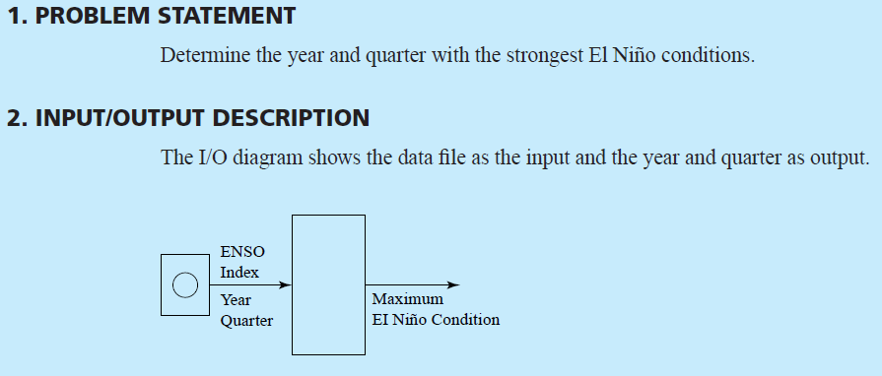
Problem Solving Applied:
El Niño-Southern Oscillation Data
Copyright © 2012 Pearson Education, Inc.

Slide 28
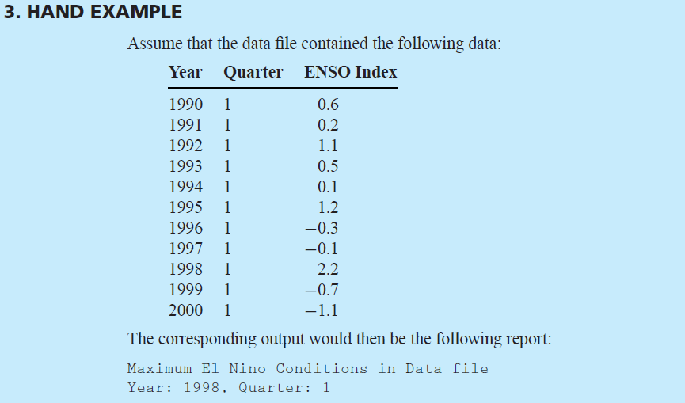
Problem Solving Applied:
El Niño-Southern Oscillation Data
Copyright © 2012 Pearson Education, Inc.

Slide 29
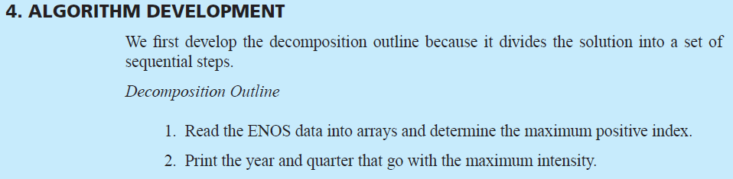
Problem Solving Applied:
El Niño-Southern Oscillation Data
Copyright © 2012 Pearson Education, Inc.

Slide 30
Dynamic Memory Allocation
Copyright © 2012 Pearson Education, Inc.

Slide 31
Allocation of Memory
Memory for variables is allocated from
one of several classes:
  Run-time stack
    Local variables
    Formal parameters
    Managed by the compiler
  Heap
    Dynamic storage
    Managed by storage allocator
  Global Data
    Static (global) variables
    Managed by the compiler
Stack
Heap
Global data
Program code
Copyright © 2012 Pearson Education, Inc.

Slide 32
Dynamic Memory Allocation
Dynamically allocated memory is
defined at runtime.
Dynamic allocation of memory allows for more efficient use of a finite resource.
Dynamic allocation is often used to support dynamic data structures such as stacks, queues, linked lists and binary trees.
Dynamically allocated memory should be freed during execution when it is no longer needed.
Copyright © 2012 Pearson Education, Inc.

Slide 33
Operator new
Replaces malloc() used in C
Allocates a block of memory from the heap.
Returns the address of the first byte.
If allocation fails, new throws an exception that terminates the program (or returns NULL on older compilers).
Copyright © 2012 Pearson Education, Inc.

Slide 34
Example
int *iPtr;
iPtr = new int;// 4 bytes are allocated
// iPtr points to 1st byte
double *dPtr;
dPtr = new double[20]; // 160 bytes allocated
// dPtr points to 1st byte
iPtr
?
?
?
?
?
…
?
?
heap
dPtr
Copyright © 2012 Pearson Education, Inc.

Slide 35
Initializing Dynamically Allocated Memory
To initialize a dynamically allocated
object, the initial value is provided inside parentheses following the type.
Example:
int *iPtr;
iPtr = new int(100); //4 bytes allocated
//initial value: 100
Copyright © 2012 Pearson Education, Inc.

Slide 36
Operator delete
Replaces free() used in C.
The delete operator frees memory allocated by new.
Using delete to attempt to free any other type of address will result in errors.
Copyright © 2012 Pearson Education, Inc.

Slide 37
Example
int *iPtr;
iPtr = new int(100);
cout << *ptr;
delete iPtr;
//memory manager is now free to reallocate
//freed memory to other programs
//accessing freed memory may or may not result
//in errors. Good idea to set pointer to null
iPtr = NULL;
ptr
100
ptr
?
Copyright © 2012 Pearson Education, Inc.

Slide 38
Example: Dynamically Allocated Arrays
double *dptr;
const int SIZE = 10;
dptr = new double[SIZE]; //80 bytes
for(int i=0; i<SIZE; ++i)
cin >> dptr[i];
fun1(dptr, SIZE); // pass array to fun1
delete [] dptr; //free all 10 elements
Copyright © 2012 Pearson Education, Inc.

Slide 39
Problem Solving Applied:
Seismic Event Detection
Copyright © 2012 Pearson Education, Inc.

Slide 40
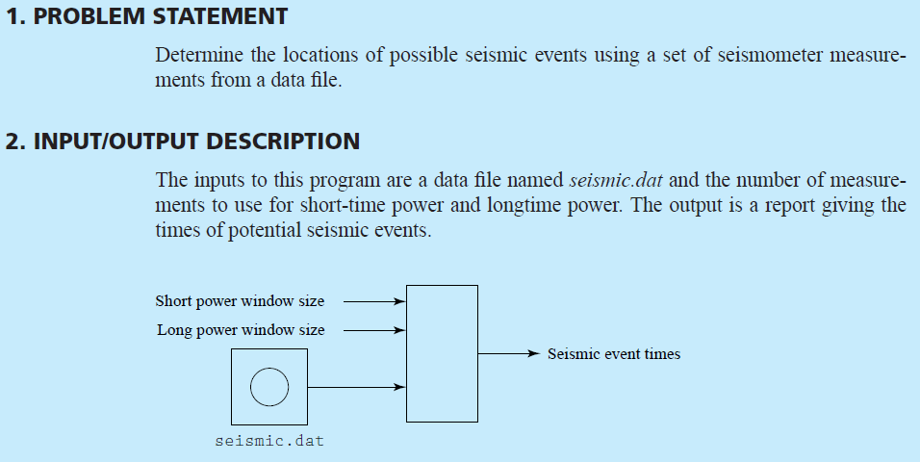
Problem Solving Applied:
Seismic Event Detection
Copyright © 2012 Pearson Education, Inc.

Slide 41
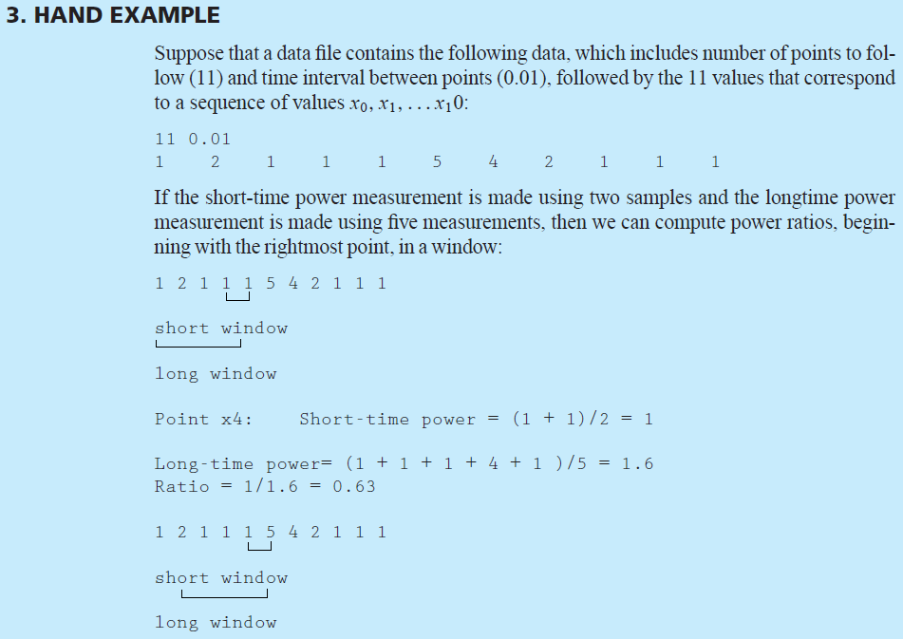
Problem Solving Applied:
Seismic Event Detection
Copyright © 2012 Pearson Education, Inc.

Slide 42
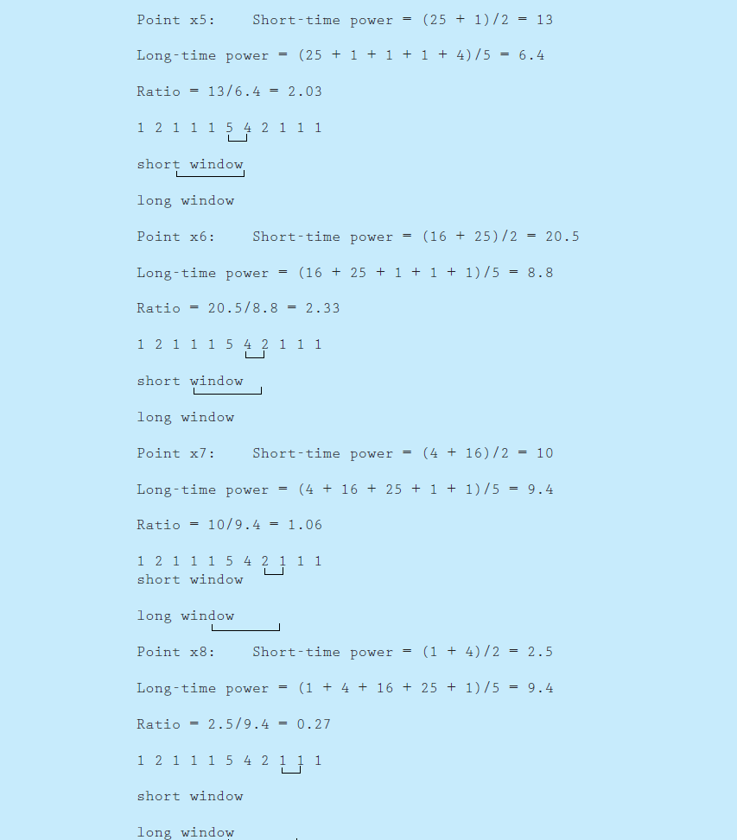
Problem Solving Applied:
Seismic Event Detection
Copyright © 2012 Pearson Education, Inc.

Slide 43
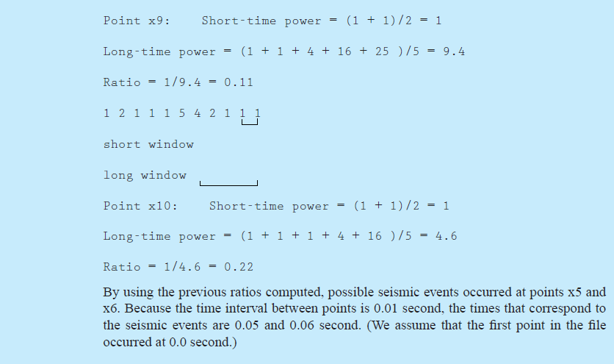
Problem Solving Applied:
Seismic Event Detection
Copyright © 2012 Pearson Education, Inc.

Slide 44
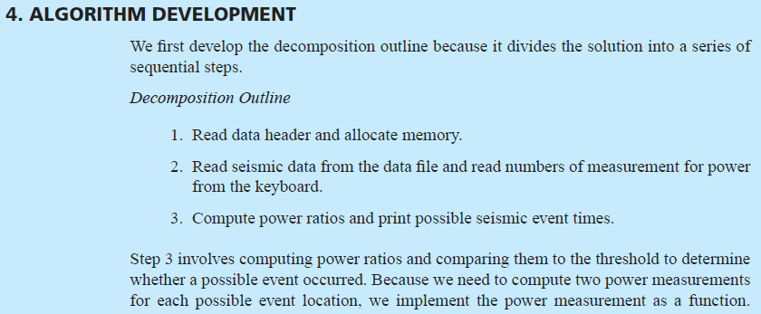
Problem Solving Applied:
Seismic Event Detection
Copyright © 2012 Pearson Education, Inc.

Slide 45
Common Errors Using new and delete
Copyright © 2012 Pearson Education, Inc.

Slide 46
Memory Management
Dynamically allocated memory should
always be returned to the heap once it is no longer needed to allow for the reuse of the memory.
Careful tracking of pointers to this memory is required.
Strategies for managing pointers often involve establishing an owner of each an every piece of dynamic memory.
  The owner is responsible for deleting the memory when it is no longer needed.
Copyright © 2012 Pearson Education, Inc.

Slide 47
Common Dynamic Memory Errors
Referencing a pointer to dynamically allocated memory after delete has been called to return the memory to the heap.
Failing to return memory when it is no longer being used.
  Often called a memory leak.
Using the delete operator with a pointer that does not reference memory that has been dynamically allocated using the new operator.
Omitting the square brackets when using delete to free a dynamically allocated array.
Copyright © 2012 Pearson Education, Inc.

Slide 48
Linked Data Structures
Copyright © 2012 Pearson Education, Inc.

Slide 49
Why Linked Data Structures?
Array-based data structures (C++
arrays, vector, string) are efficient for accessing elements.
  Offset-based access to elements from the base address is very fast.
The restriction that memory is a contiguous block has consequences.
  STL makes this less painful for the programmer by encapsulating memory management into the objects; however there are still consequences.
Insertion and deletion of elements are expensive
Copyright © 2012 Pearson Education, Inc.

Slide 50
Linked Data Structures
Linked data structures avoid the
restriction that the memory of a data structure be contiguous.
Pointers connect (i.e. link) pieces of the data structure together.
Simple linked data structures include:
  Linked lists
  Stacks
  Queues
Copyright © 2012 Pearson Education, Inc.

Slide 51
Linked List
A linked list is a data structure in which each element of the list consists of the data stored in the element and a pointer to the next element in the list.
  Usually keep a pointer to the first element of the list (the head of the list)
Inserting an element to a particular place in the list is very efficient, but traversing the list is not.
  This is the exact opposite characteristics of array operations!
Copyright © 2012 Pearson Education, Inc.

Slide 52
Stack
A queue is a sequential container like
the linked list and queue.
Last-In, First-Out (LIFO) data
structure.
  Thus one may only remove (pop) from one ‘end’ of the data structure, and only insert (push) to the same ‘end’.
Essential in the design of design of compilers, operating systems, etc.
Copyright © 2012 Pearson Education, Inc.

Slide 53
Queue
A queue is a sequential container like
the linked list.
First-In, First-Out (FIFO) data
structure.
  Thus one may only remove (pop) from one ‘end’ of the data structure, and only insert (push) to the other ‘end’.
Often used in processing of job requests.
  E.g. printer queues.
Copyright © 2012 Pearson Education, Inc.

Slide 54
The C++ Standard Template Library (STL)
Copyright © 2012 Pearson Education, Inc.

Slide 55
Sequential STL Containers
List
Stack
Queue
Copyright © 2012 Pearson Education, Inc.

Slide 56
STL List
A list is a data structure organized as a collection of elements, or nodes, that are linked by pointers.
Elements can be added at any position in a list in constant time by reassigning pointers.
List have many useful applications in the organization large amounts of data.
Copyright © 2012 Pearson Education, Inc.

Slide 57
The STL list Class
list is a class template defined in the header file list.
Example
#include <string>
#include <list>
using namespace std;
list<string> word; //list of strings
Copyright © 2012 Pearson Education, Inc.

Slide 58
Methods of list Class
Elements can be added to and removed
from any position in a list using the
appropriate method and an iterator.
An iterator is similar to a pointer, but is usually implemented as a class object.
Common Methods of List Class:
bool empty()
iterator insert()
iterator remove()
iterator begin()
iterator end()
Copyright © 2012 Pearson Education, Inc.

Slide 59
Example
list<string> wordList;
list<string>::iterator iter =
wordList.begin();
iter = wordList.insert(iter,"hello");
wordList.insert(iter,"world");
for (iter=wordList.begin();
iter!= wordList.end();
iter++)
cout << *iter << " ";
Output:
hello world
Copyright © 2012 Pearson Education, Inc.

Slide 60
The STL queue Class
queue is a class template defined in the header file queue.
Example
#include <queue>
using namespace std;
queue<int> word; //queue of integers
Copyright © 2012 Pearson Education, Inc.

Slide 61
Methods of queue Class
bool empty();
void pop(); //remove from front
void push(data_type); //add to end
data_type front(); //return front
data_type back(); //return end
Copyright © 2012 Pearson Education, Inc.

Slide 62
Example
#include <queue>
#include <iostream>
using namespace std;
…
queue<int> theQueue;
theQueue.push(10);
theQueue.push(20);
theQueue.push(30);
while (!theQueue.empty() ) {
cout << theQueue.front() << endl;
theQueue.pop();
}
Output:
10
20
30
Copyright © 2012 Pearson Education, Inc.

Slide 63
The STL stack Class
stack is a class template defined in the header file stack.
Example
#include <stack>
using namespace std;
stack<int> word; //stack of integers
Copyright © 2012 Pearson Education, Inc.

Slide 64
Methods of stack Class
bool empty();
void pop(); //remove from top
void push(data_type); //add to top
data_type top(); //return top
Copyright © 2012 Pearson Education, Inc.

Slide 65
Example
#include <stack>
#include <iostream>
using namespace std;
…
stack<int> theStack;
theStack.push(10);
theStack.push(20);
theStack.push(30);
while (! theStack.empty() ) {
cout << theStack.top() << endl;
theStack.pop();
}
Output:
30
20
10
Copyright © 2012 Pearson Education, Inc.

Slide 66
Problem Solving Applied:
Concordance of a Text File
Copyright © 2012 Pearson Education, Inc.

Slide 67
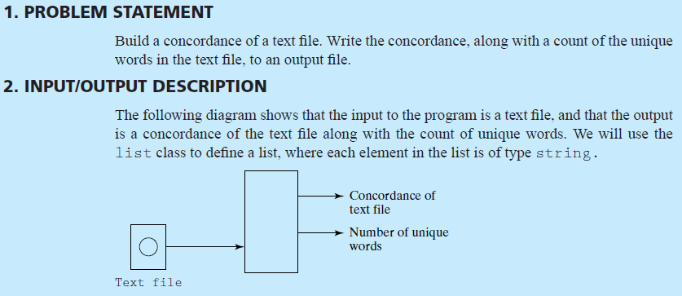
Problem Solving Applied:
Concordance of a Text File
Copyright © 2012 Pearson Education, Inc.

Slide 68
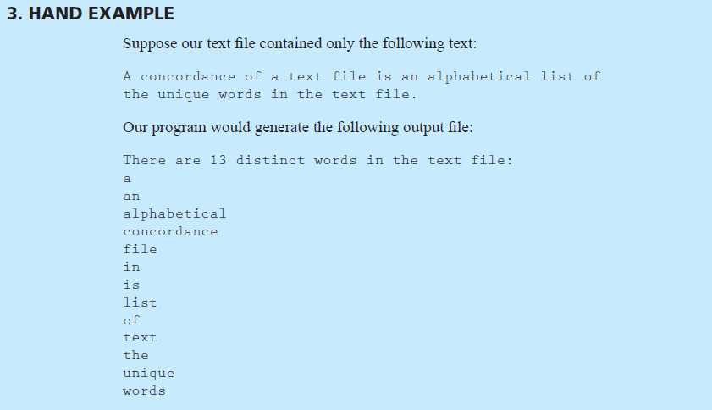
Problem Solving Applied:
Concordance of a Text File
Copyright © 2012 Pearson Education, Inc.

Slide 69
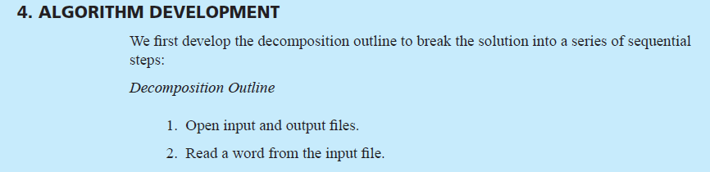
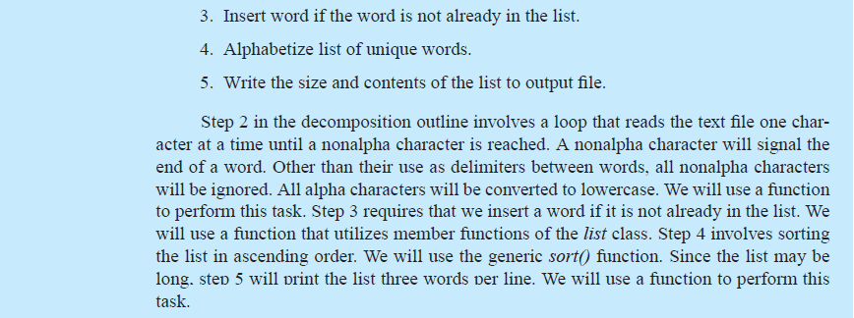
Problem Solving Applied:
Concordance of a Text File
Copyright © 2012 Pearson Education, Inc.

